Slide 1
PEMROGRAMAN BERORIENTASI OBJEK
00. Satuan Acara Perkuliahan (SAP)
Teguh Pribadi
http://www.teguhpribadi.com
wa/telegram 0857 3600 3963 || wa/call 082 337 475 885

Slide 2
Satuan Acara Perkuliahan (SAP)
Informasi Matakuliah
Kebutuhan Software
Referensi
Contact

Slide 3
1) Informasi Matakuliah

Slide 4
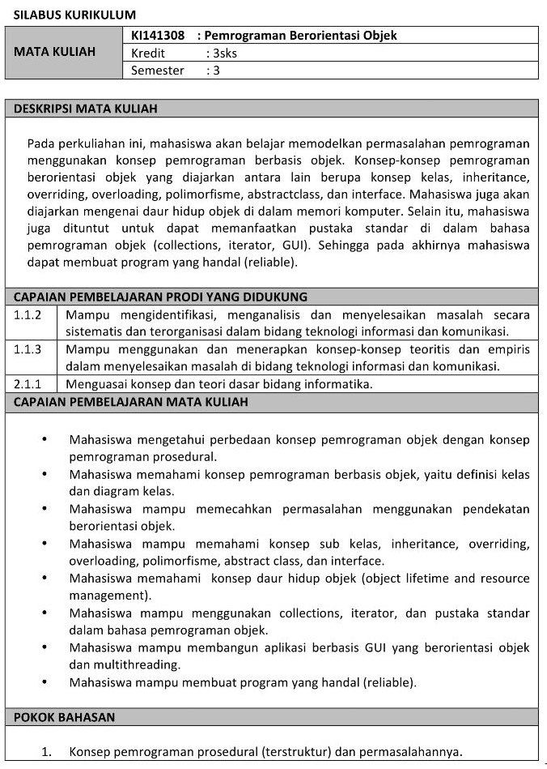
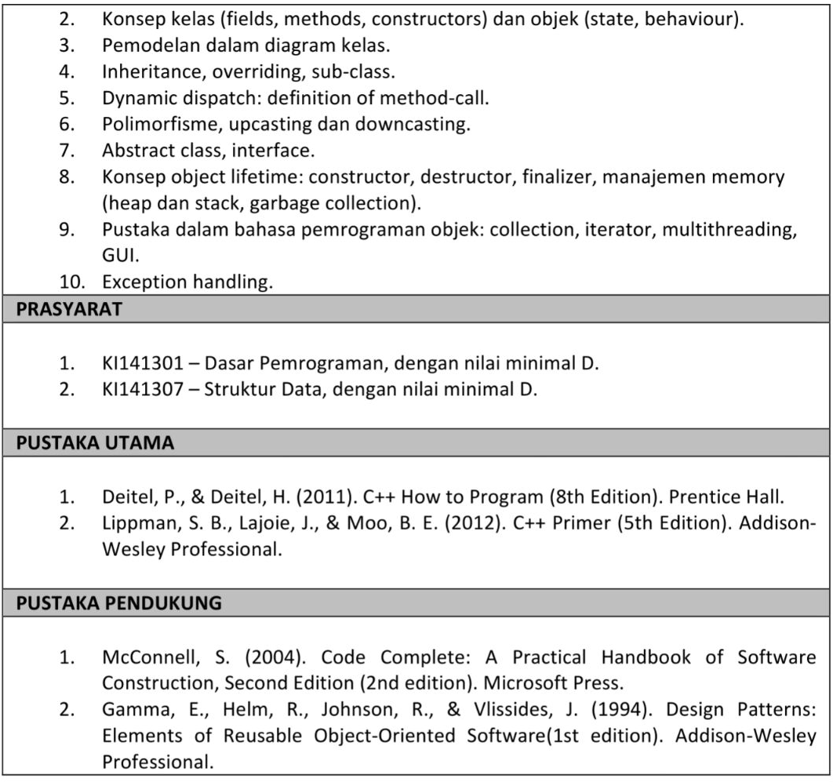
Informasi Matakuliah

Slide 5
2) Kebutuhan Software

Slide 6
Kebutuhan Software
Browser
  Adobe flash
  Chrome
  Firefox
  Maxton
  Opera
  Safari
  UC browser
Localserver
  Xampp
  Laragon
Editor
  Notepad++
  Atom
  Sublime Text
Database GUI
  HeidiSQL
  SQLYog

Slide 7
3) Referensi

Slide 8
Referensi (1)
Andrea Tar. 2012. PHP and MySQL 24-Hour Trainer
Brett McLaughlin. 2012. PHP & MySQL- The Missing Manual. USA-Brett McLaughlin. USA-O'REILLY Media
Brett McLaughlin. 2013. PHP & MySQL- The Missing Manual, 2nd Edition. USA-Brett McLaughlin. USA-O'REILLY Media
Deitel, Harvey and Paul Deitel. 2007. Internet & World Wide Web, How to Program. 4th Edition. Prentice Hall
Fadila, Armando dkk. Pro PHP Application Performance
Gilmore, W. Jason. 2010. Beginning php and mysql from novice to professional, 4th edition
Head First PHP & MySQL
Kroenke, David. 2013. Database Processing 12th Edition
Lamandi, BB dkk. 2009. AJAX and PHP Building Modern Web Applications, 2nd Edition
LesLie. Web Standards Mastering HTML5, CSS3, dan XML
Loka Dwiartara. Menyelam dan Menaklukan Samudra PHP
Michcel, Lorna Jane. PHP Web Services
Mysql Official. 2016. MySQL 5.7 Reference Manual-en
Official. php_manual_en
PHP6 and MySQL Bible by Steve Suehring

Slide 9
Referensi (2)
Power, David. PHP Solutions, 3rd Edition
Powers, David. 2010. PHP Solutions Dynamic Web Design Made Easy 2nd Edition. Friendsoft-Apress company-USA
Robert W. Sebesta. 2014. Programming the World Wide Web 2014 (8th Edition). Addison Wesley
Rochkin Mark. 2013. Expert PHP and MySQL
Rosihanari. Basic PHP Tutorial
Ruehning, dkk. php_mysql_javascript__html5_all-in-one_for_dummies
Sams.Sams.Teach.Yourself.PHP.MySQL.and.Apache.All-in-One.ISBN0672326205
Solichin, Achmad. Pemrograman Web dengan PHP MySQL
Tatro, Kvein, dkk. 2013. Programming PHP, 3rd Edition. USA-O'REILLY Media
Tutorialpoints.com - mysql tutorial
Valade, Janet. PHP & MySQL Web Development All-in-One Desk Reference For Dummies. CanadaWiley Publishing,Inc
W3Schools Offline 2018
Wahono, Romi Satria. dasar-php
Welling, Luke and Laura Thomson. 2015. Welling php mysql web 3rd. USA - Sam Publishing
Widigdo, Anon Kuncoro. 2003. php dan mysql
Zandstra, Matt. PHP Objects, Patterns, and Practice, 4th Edition

Slide 10
4) Contact

Slide 11
Contact
Email : pribadi.unugiri@gmail.com
Site : http://www.teguhpribadi.com
WA/Telegram : 0857 3600 3963 || 082 337 475 885

